Slide 1
Some thoughts about Data model

Slide 2
Previous ideas

Slide 3
First: What is data model? ISO’s view
We have found 57 results about data model by searching in the “terms and definitions” item in the above website.
We sought 7 main definitions listed in the table. The orange are what I think most related with us.
Data Model
Definition: graphical and/or lexical representation of data, specifying their properties, structure, and inter-relationships
Definition: graphical and textual representation of analysis that identifies the data needed by an organization to achieve its mission, functions, goals, objectives, and strategies and to manage and rate the organization. A data model identifies the entities, domains (attributes), and relationships (associations) with other data and provides the conceptual view of the data and the relationships among data. [key style]
1
ISO Standard: ISO/IEC 11179-1:2015；ISO/IEC 20006-1:2014；ISO 26162-1:2019；ISO/IEC 2382-36:2019；ISO/TR 17185-3:2015；ISO/IEC 19778-1:2015；ISO/IEC 16350:2015
5
Definition: abstract representation of an XML document defined by this part of ISO/IEC 19757
2
ISO Standard: ISO/IEC 19757-2:2008
ISO Standard: ISO/IEC/IEEE 31320-2:2012；ISO/IEC 25024:2015
Definition: representation of the specific information requirements of a business area
Definition: pattern of structuring data in a database according to the formal descriptions in its information system and according to the requirements of the database management system to be applied
3
6
ISO Standard: ISO 22307:2008
ISO Standard: ISO/IEC 2382:2015
Definition: set of constructs that provides the definition, structure, and format of data, whether physical or abstract in the sense of being bound to some recording medium
Definition: description of the organization of data (3.1.1.15) in a manner that reflects an information (3.1.1.16) structure
4
7
ISO Standard: ISO 5127:2017；ISO 28258:2013
ISO Standard: ISO/TS 18876-1:2003
Source: https://www.iso.org/obp/ui/#home

Slide 4



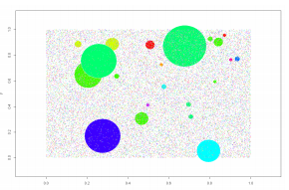
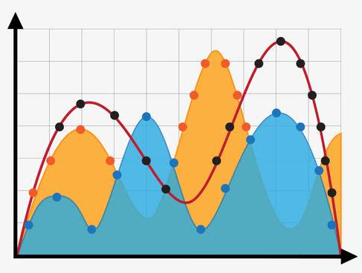
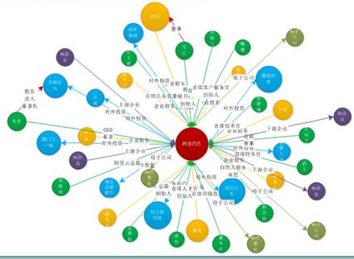
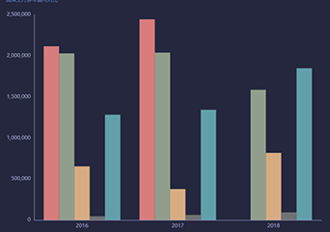
The potential role of data model
Benefits VS Costs ：the more we want the more be pay
Auditees
Auditors
Output from
business system
Import data into
audit system
Business system
Exchange file
Audit system
Collection
Pre-processing
Management
Analysis
Interoperability
Data eliminating duplication and redundancy
System development
Knowledge reasoning
Verification
Flexibility
Exchange and sharing of information
Restructuring of existing business vocabularies
Data services
management
Decision-making

Slide 5
Different ways of data model
Different ways even for same goal
Common business documents in commercial and logistical processes for domestic and international supply chains such as Order, Dispatch Advice, and Invoice, etc.
The general methods for data modeling
Information technology — Metadata registries (MDR) (ISO/IEC 11179)
Universal Business Language (UBL)
Electronic Business Extensible Markup Language (ebXML) — Part 5: Core Components Specification (CCS) (ISO 15000-5:2014)
Aggregates information that needs custom business and related cross-border regulators
WCO Data Model
(3.0)
Data model for international trade information especially related with customs
Extensible Business Reporting Language
(XBRL) 2.1
Especially for financial report exchange
Core Components Technical Specification Part 8 of the ebXML Framework(Version 2.01)(CCTS)
TC 295’s own way?

Slide 6
Some new thoughts about
data model

Slide 7
General Process of Audit Data Services
Auditees
Auditors
Output from
business system
Import data into
audit system
Business system
Exchange file
Audit system
Collection
Pre-processing
Management
Analysis
who will use the data model?

Slide 8
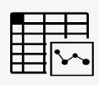






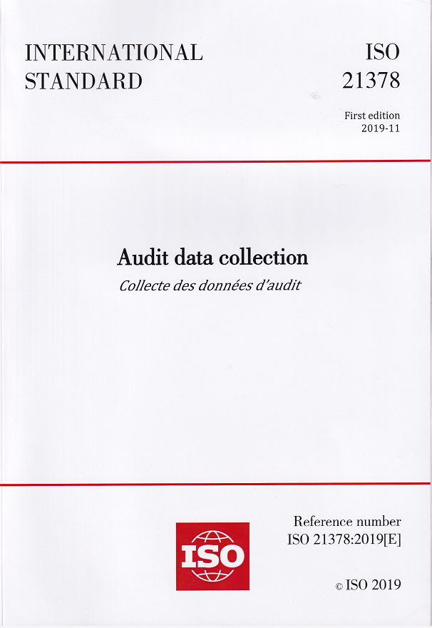


Possible users
Auditees
Auditors
Exchange file
Business system
Audit system
Analysis
CSV
ISO/TS
WD5409
Vendors and
Software developers
…
Vendors and
Software developers
XBRL-GL
Data
model
Collection Standard

Slide 9
The potential role of data model
Reusing common information object so as to reduce repetitive work
Table 14 — BAS_Customer
Name | Data- type | Repre- sentation | Description | Level
Customer_Street_Address1 | String | %100s | Line 1 of the customer’s physical street address. | 1
Customer_Street_Address2 | String | %100s | Line 2 of the customer’s physical street address. | 1
Customer_City | String | %100s | Physical city where the customer is located. | 1
Customer_State_Province | String | %6s | Physical state or province where the customer is located (in accordance with ISO 3166-2). | 2
Single standard
21378
Table 18 — BAS_Supplier
Extract
Name | Data- type | Repre- sentation | Description | Level
Supplier_Billing_Address1 | String | %100s | Line 1 of the supplier’s billing address. | 1
Supplier_Billing_Address2 | String | %100s | Line 2 of the supplier’s billing address. | 1
Supplier_Billing_City | String | %100s | Billing city of the supplier. | 1
Supplier_Billing_State_PRV | String | %6s | Billing state or province of the supplier (in accordance with ISO 3166-2). | 1
Supplier_Billing_Postal_Code | String | %20s | Billing postal code of the supplier’s city. | 1
Supplier_Billing_Country | String | %3s | Billing country code of the supplier (in accordance with ISO 3166-1). | 1
Address

Slide 10
The potential role of data model
Single standard
Multi standards in
Multi areas
Cross border
Information exchange in tax and custom
21379
Tax
21378
21378
21380
Enterprises
Social insurance
Extract
21381
Financial reports
Similar to CCL
Address

Slide 11
The potential role of data model
Auditees
Auditors
Output from
business system
Import data into
audit system
Business system
Exchange file
Audit system
Collection
Pre-processing
Management
Analysis
Interoperability
Data eliminating duplication and redundancy
System development
Knowledge reasoning
Verification?
Flexibility
Exchange and sharing of information
Restructuring of existing business vocabularies
Data services
management
Decision-making

Slide 12

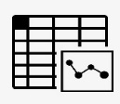


The potential role of data model
Auditees
Auditors
One
One format
One
Business system
Exchange file
Audit system
Analysis
include
Verification
…
XBRL-GL
Business requirements
C=A+B
We only verify the technical format of audit information, such as YYYY/MM/DD ,but we seldom verify business requirements in collection. These requirements are usually adopted in audit analysis.
Audit analysis is usually based on database, especially for big data volume
Each time we will collect one output format from one auditee, not several formats.
Notes:
Audit analysis is usually based on database, especially for big data volume

Slide 13
What’s the method for
data modelling

Slide 14
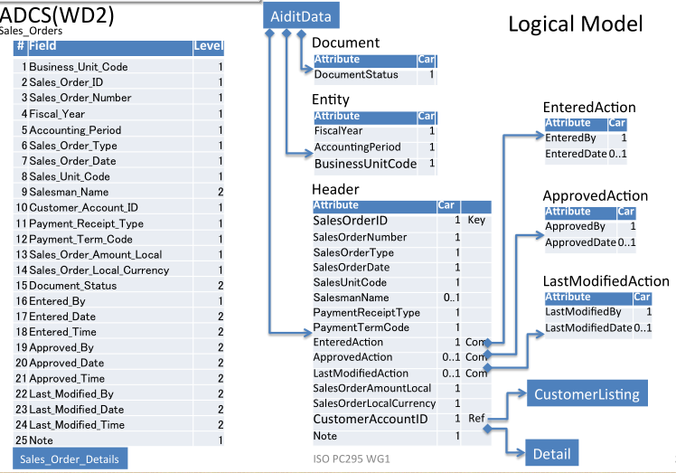
Result from Prof. Nobu

Slide 15
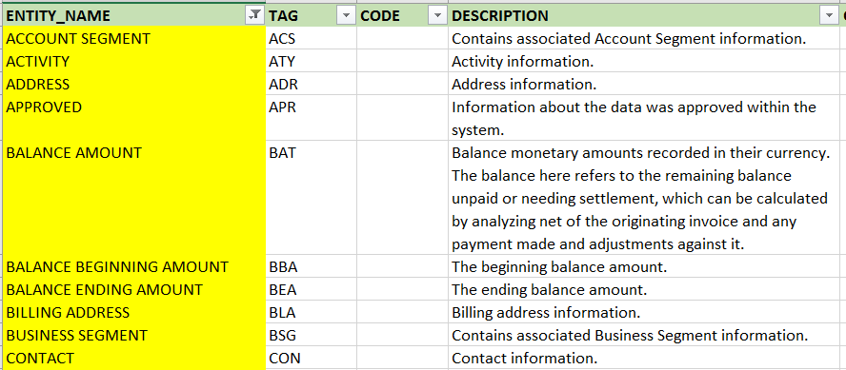
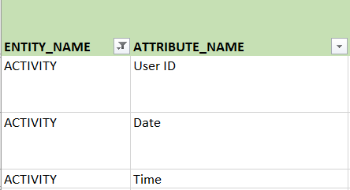
Result from Netherlands experts

Slide 16
one table as one entity or ABIE(aggregate business information entity).
1
The data elements usually appear together are grouped as one entity or ACC (aggregate core component).
2
Not every data element is re-abstracted in the data model.
3
In both cases, only less than 30 entities or ACC (except tables) are constructed.

Slide 17
One way of data modelling we prefer
Tax information
Tax_Type_Code | String | %25s
Tax_Local_Amount | Decimal | %22.4f
GL_Tax_Debit_Account_Number | String | %100s
GL_Tax_Credit_Account_Number | String | %100s
Core data model
data model in every area
+
28 entities
Address
Street_Line1 | String | %100s
Street_Line2 | String | %100s
City | String | %100s
State_Province | String | %6s
Physical_Postal_Code | String | %20s
Country | String | %3s
21378
1000+ elements
enterprises

